Slide 1

Data Watchdog
Features:
1) Data Ingestion using PostgreSQL and AWS Cloud
2) Comprehensive PII Identification
3) Classification of PII in buckets such as Personal, Medical, Financial etc.
4) Risk Assessment of PII
5) Data Analytics
Presented by Team CodeRed
01

Slide 2
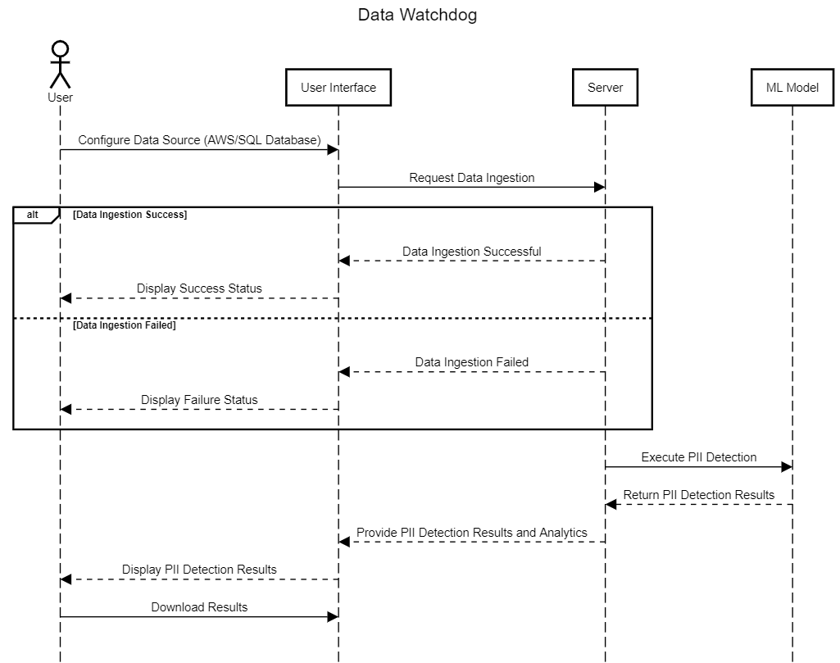
Sequence Diagram
To get started, users need to configure their preferred data store, whether it's AWS Cloud Store or SQL. We offer an easy-to-use form interface where users can input their credentials. Once the connection to the data source is established, our server will automatically download the files. If there's an issue connecting to the data source, users will informed of the same.
Afterward, the server will apply the machine learning model to detect Personally Identifiable Information (PII) within the files and generate detailed analytics. Additionally, users have the option to download their files at any time.
02

Slide 3
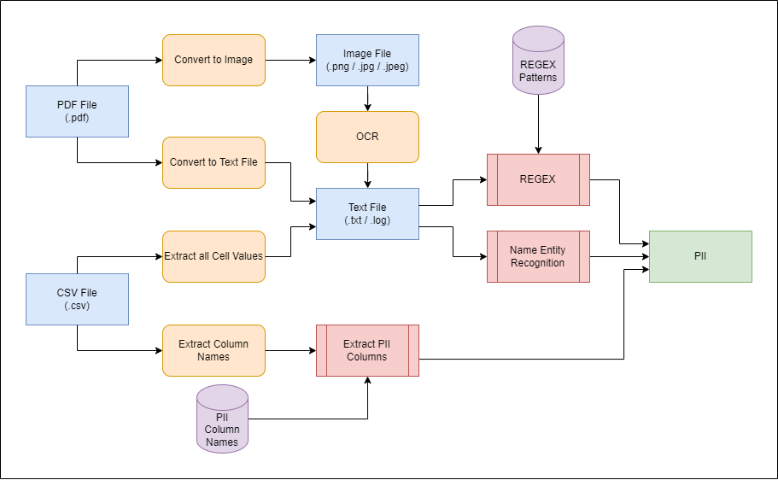
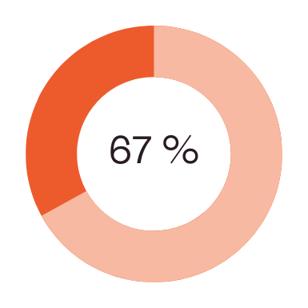
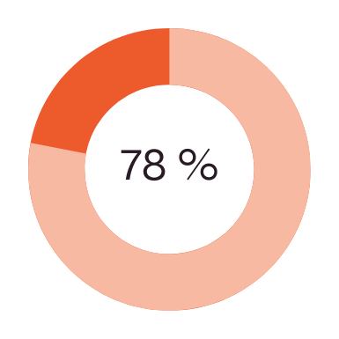
Methodology
The tool supports various file types, including unstructured files (such as .txt, .log, .jpg, .pdf) and structured files (such as .csv).
For all the files, we convert them to string format and/or image format (using OCR) and then perform following:
1) Regular Expressions (REGEX): Used to detect PII with fixed patterns, such as email addresses, IP addresses, Aadhar numbers, and credit card numbers.
2) Named Entity Recognition (NER): Utilizes pre-trained models to identify PII such as personal names, locations, and organizations.
For CSVs, we perform one extra step of extracting column names and checking if they match with column names that indicate PII.
03

Slide 4
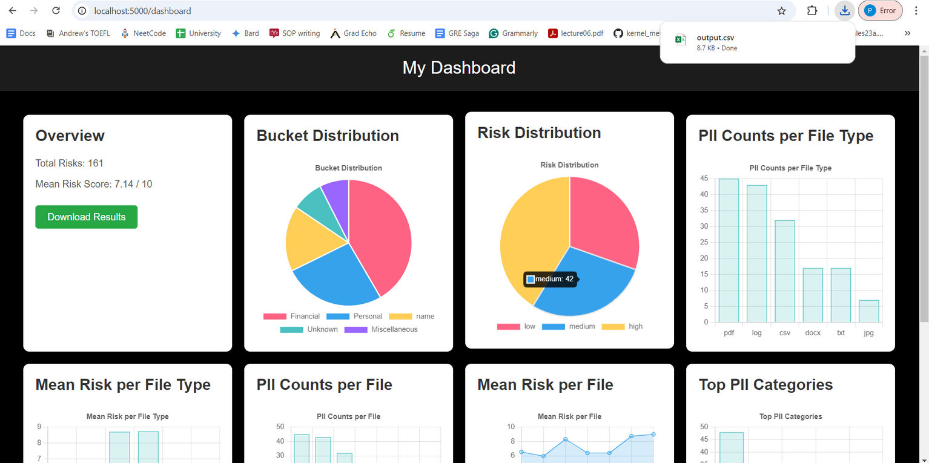
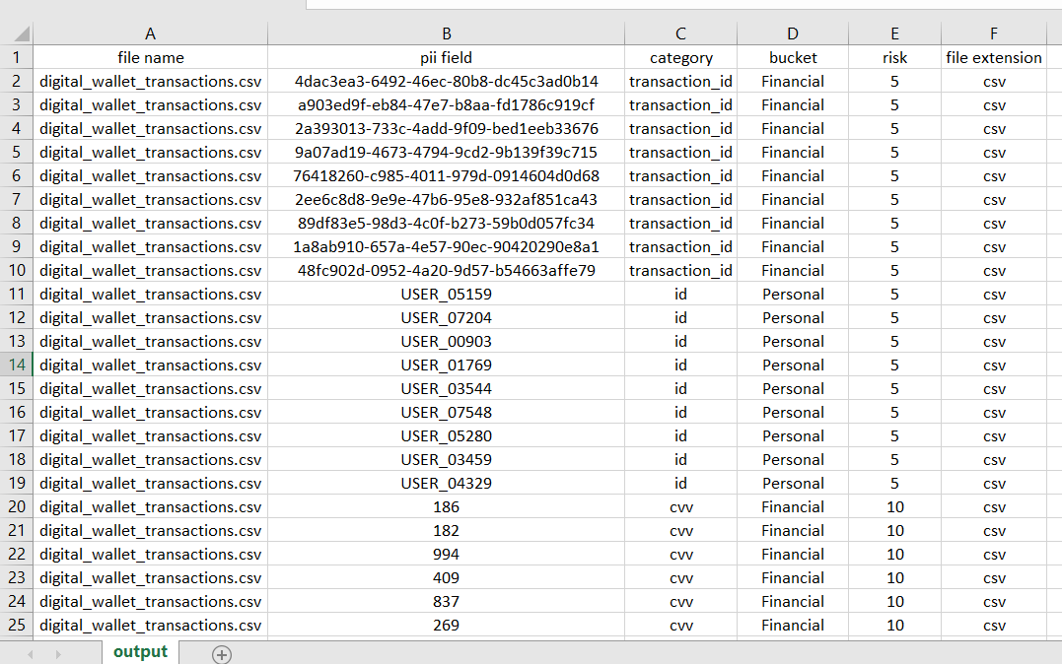
Analytics
We offer the following analytics and results to user based on PII Detected:
1) Total Risks
2) Mean Risk Score
3) Bucket Distribution (e.g. Personal, Financial, Medical etc.)
4) Risk Distribution (e.g. High, Low)
5) PII Counts per File Type
6) PII Counts per File
7) Mean Risk per File Type
8) Mean Risk per File
9) Top 5 PII Categories (e.g. Name, Email, CVV etc.)
10) Full Results
04

